Slide 1
Search Your Neighbourhood Using Open Data
Eric Charton, Ph.D.
Relevance & Knowledge lab Lead

Slide 2
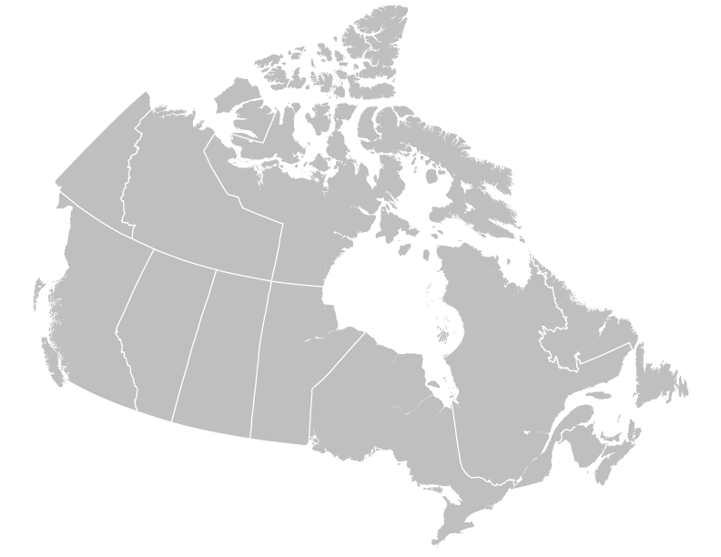

Search Your Neighbourhood Using Open Data
What is local search ?
Local search is the use of specialized Internet search engines that allow users to submit geographically constrained searches against a structured database of local business listings.
Examples of local search engines
YP.ca YP.com, Pagesjaunes.fr, Yelp, Facebook for local businesses …
In Canada
22M users
500 M visits / year
500M visits
Local topics Restaurants / Home & services / legal …

Slide 3
Search Your Neighbourhood Using Open Data
Information architecture challenges
Search engine need to be supported by a powerful information architecture
Merchant content
Search engine to search for local businesses
A search engine is used to retrieve local search related content and information. Three main categories of information need to be available :
Merchant content
Used to feed the search engine and help it to retrieve the relevant listing. Can be keywords, business names, address, category…
Informative content
Geo Content
Geo Content
Used to locate merchants according to the user location…
Informative content
The information displayed to answer to the user needs : images, textual description, open hours, deals …

Slide 4
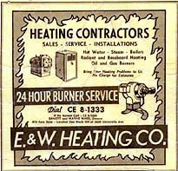
Search Your Neighbourhood Using Open Data
A lot of legacy
Over one century, companies specialized in printed telephone directories have developed methods and techniques to collect and structure information about local businesses in the perspective of publishing those information through a very specific medium: printed directories.

Slide 5
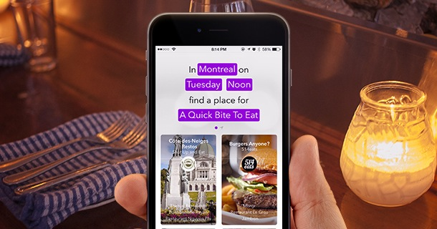
Search Your Neighbourhood Using Open Data
The digital transformation
Nowadays, distributing local related information is mainly performed through modern and interactive platforms like smart-phones.
Thus, this new way of listing businesses involves much more data.
more descriptive textual content to help determine its business category (plumber, lawyer...)
metadata as hours of operation …
All these mandatory contents are difficult to collect through traditional information extraction processes.

Slide 6
Search Your Neighbourhood Using Open Data
Information architecture challenges
Where are the data
How to use the data
How to process the data
Data are difficult to collect
Searching with incomplete data is a challenging task
User content is sometime available but difficult to process
Local businesses rarely offer exhaustive and easy to access content like websites or documentation. Usual techniques (crawl, information extraction) are sometimes inefficient. Historical system – telco data – cant be used alone.
Information retrieval systems involved in local search need access to all information to provide relevant results
Noisy data are challenging and difficult to accommodate in an information architecture dedicated to a search engine.

Slide 7
Examples

Slide 8
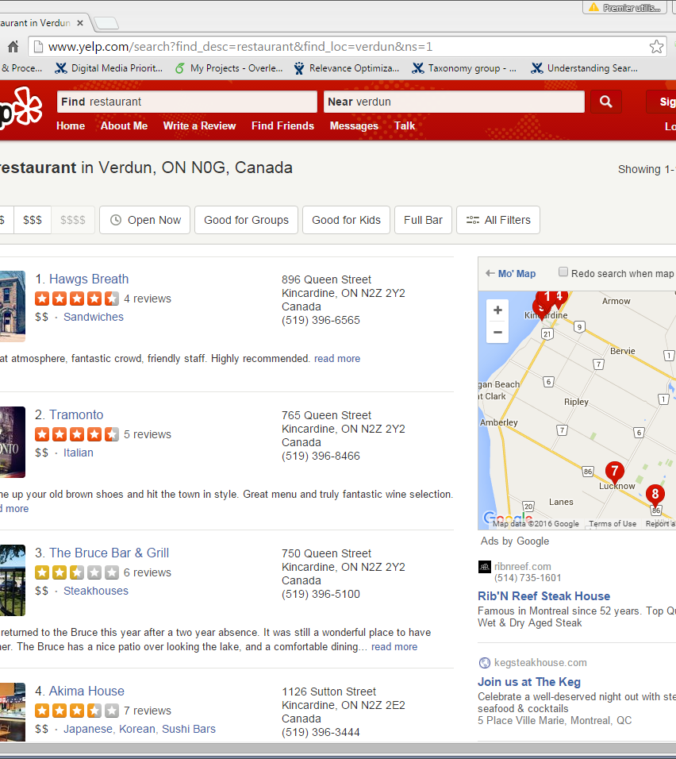
Finding the correct location
The system is in trouble if the geo-representation is not properly organized

Slide 9
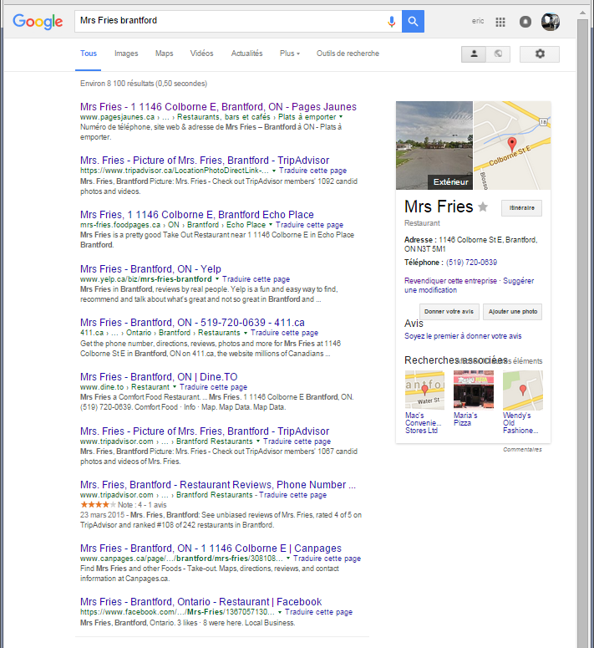
Providing useful content
How to collect web site content, textual descriptions, geo-graphical position, meta data like opening hours, to avoid empty or poor content ?

Slide 10
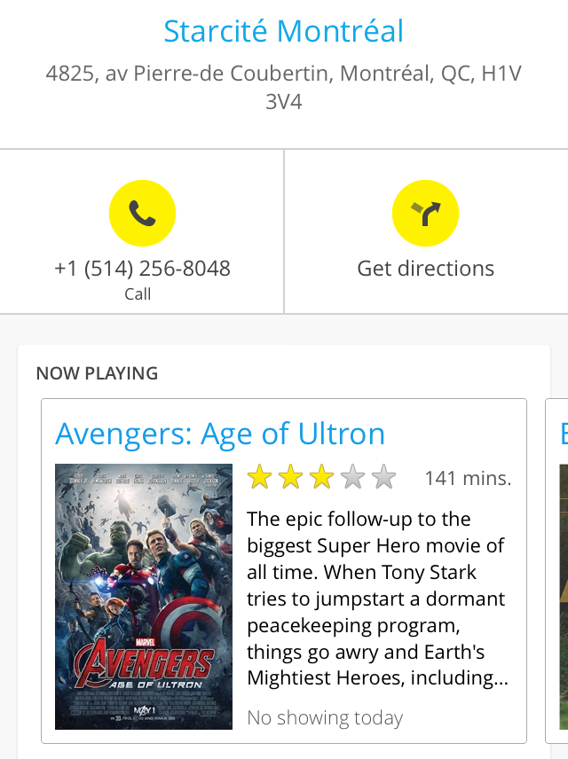
Search Your Neighbourhood Using Open Data
Deliver interactions
Content is king
Users want contextualized information like menus, opening hours, programs…

Slide 11

Search Your Neighbourhood Using Open Data
Open Data can be a solution for all those content needs
Open Data is defined as structured data that is machine-readable, freely shared, used and built on without restrictions.
The data must be available as a whole and at no more than a reasonable reproduction cost, preferably by downloading over the internet.
Re-use and Redistribution: the data must be provided under terms that permit re-use and redistribution including the intermixing with other datasets.
Universal Participation: everyone must be able to use, re-use and redistribute(*).
http://open.canada.ca/en/open-data-principles

Slide 12
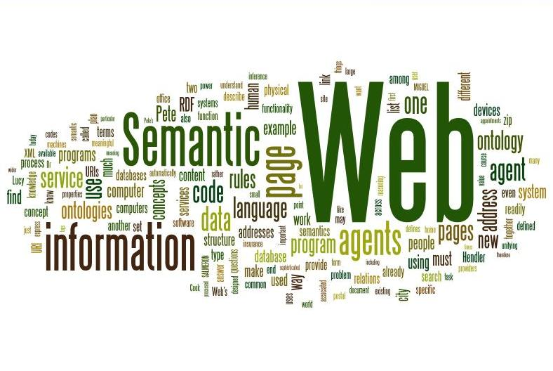

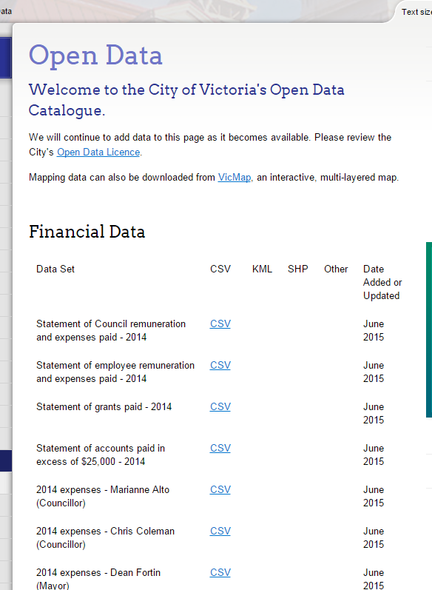
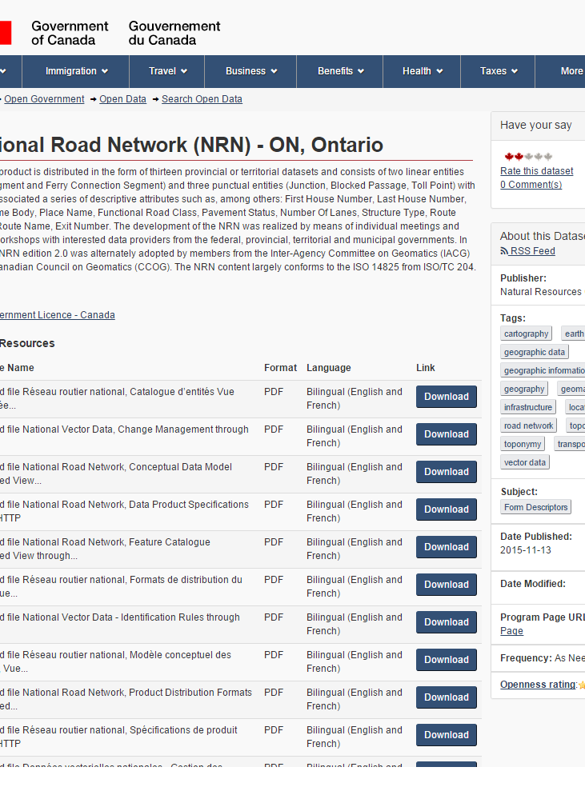
Search Your Neighbourhood Using Open Data
Sources of Open Data
Semantic web
Open Content foundations
Public catalogues
Gov data
Lexical and knowledge information like in DBPedia or Free base
Textual content to mine, on multiple topics.
Businesses, addresses, geo-data.
Geodata collection, business discovery, business content

Slide 13
Semantic Web
Can be used to enrich ontology, discover keywords, model concepts.

Slide 14
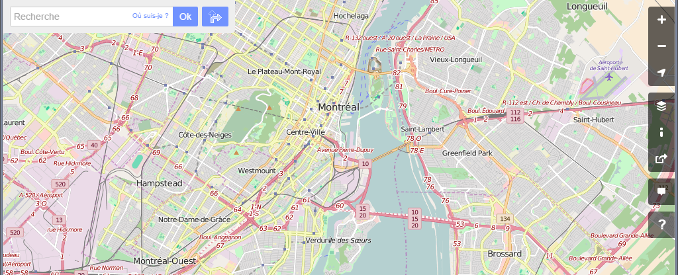
Open Geo data like OpenStreeMap are used to discover business information, geo information, point of interests …

Slide 15
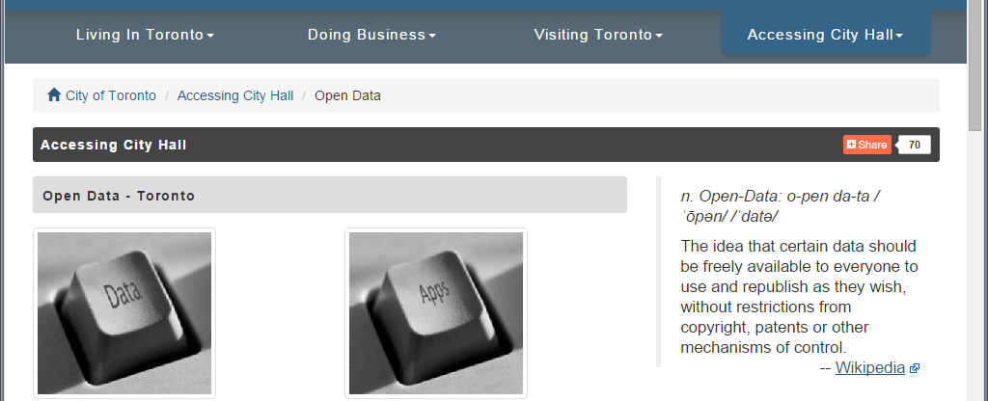
Open data are usable to collect a wide range of information: new business, business knowledge (opening hours, location …), geo information like in the National Road network.

Slide 16
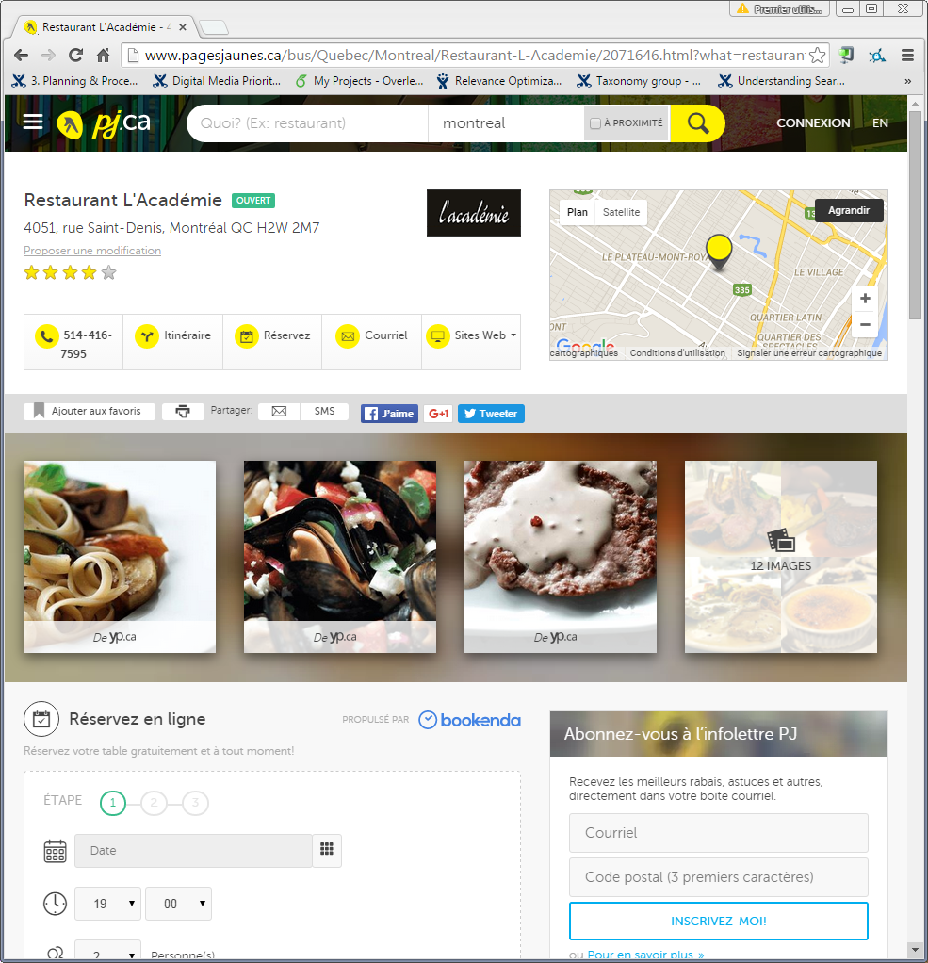
The ultimate purpose is to produce a rich profile with as much data available as possible:
Menus, pictures, opening hours, location…

Slide 17
Search Your Neighbourhood Using Open Data
The techniques to manage and collect open data …
Multiple techniques are involved to collect,
refine, transform and validate data
M
IE
NLP
Machine Learning
Information Extraction
Natural Language Processing

Slide 18
Search Your Neighbourhood Using Open Data
… and the information architecture
The search engine is supported by multiple
layers of information.
M
G
K
M
Merchant content
Geo Content
Knowledge
Meta content
Dedicated merchant content used to provide the best possible relevance : addresses, keywords, names …
Provide a precise resource to target the exact location of a user search.
Ontology layer with as much generic knowledge to globally improve performance of the search engine
Promotion, deals, programs …

Slide 19
Thank you.
Eric.charton@yp.ca

