Slide 1
Application of Recent Advances in
Language Modeling to Improve
Dialog Systems
Eric Charton, Ph.D.
20 March 2019

Slide 2
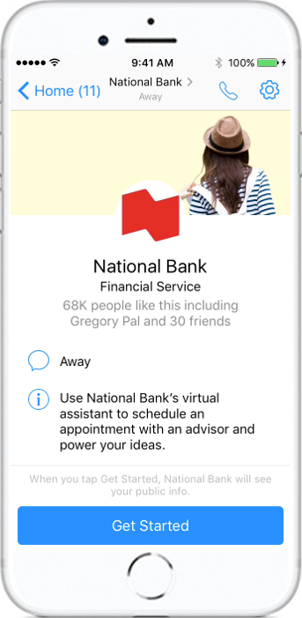
Dialog system R&D at NBC
Research Program on Robustness :
Using discourse techniques
Machine learning modeling improvements
Automatic model generation
Target:
Using bot as a self service for any activities in the bank
Internal needs (Legal advice, Procurement, Call center …)
Client facing (Q&A, Appointment, product selection …)

Slide 3
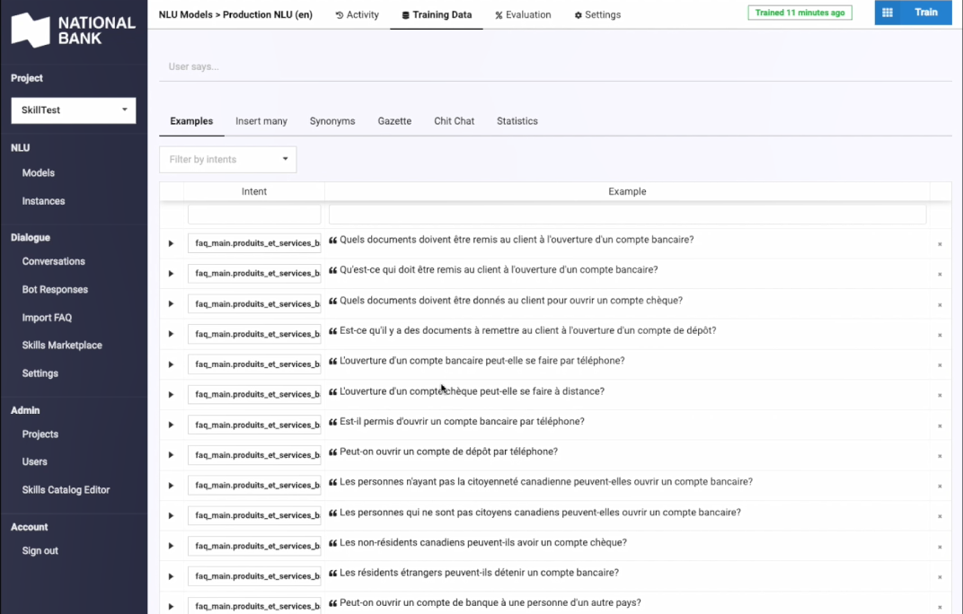
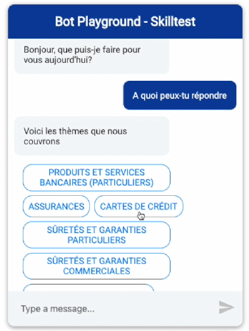
Generating easily robust dialog models using FAQ data

Slide 4
Building dialog systems
Using existing frameworks (Rasa):
NLU Classifiers (SVM – DL ) : classifying an intent
Dialog Management (LSTM TensorFlow-based) : building a dialog model
NLU Classifiers used for Q&A :
Detecting an intent according to an input – Return intent as a class
A given intent can be phrased by various sentences.
Training sample :
## intent:greet
- hey
hello
## intent:lostpin
How can I recover my pin
I lost my credit card code

Slide 5
Paraphrasing is a key aspect of dialog models
Generating a new sentence from an existing one with different lexical content and same meaning:
Paraphrasing is in fact an essential aspect of development and maintenance of modern dialog system models :
- Finding new formulations to improve robustness
Using log to extract new way of expressing an intention
Improve robustness of NLU classifiers
## intent:greet
- hey
hello
hi
## intent:lostpin
how can I recover my pin
i lost my credit card code
where can I get back my pin code

Slide 6
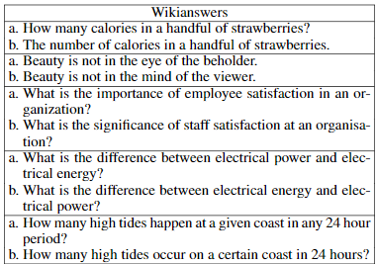
Using multi-lingual pivoting for paraphrasing
Multi-lingual pivoting has been recently shown to improve translation quality(*). This property can also be used for paraphrasing(**).
Example of paraphrases generated from Paranet output using pivotal translation(**)
Six encoder-decoder NMT models (three pairs);
English→French,French→English,English→Czech, Czech
→English, English→German, German→English from WMT15, preprocessed with Moses
(*) Multi-way, multilingual neural machine translation with a shared attention mechanism.
(*) Firat, Orhan, Kyunghyun Cho, and Yoshua Bengio. arXiv preprint arXiv:1601.01073 (2016)
(**) Paraphrasing Revisited with Neural Machine Translation
Jonathan Mallinson, Rico Sennrich and Mirella Lapata
Proceedings of the 15th Conference of the European Chapter of the Association for Computational Linguistics, Valencia, Spain, April 3-7, 2017.

Slide 7
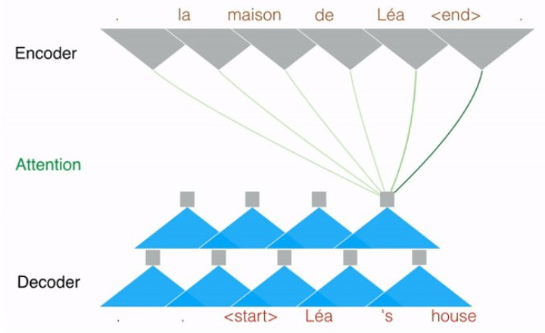
Using FairSeq and NMT(*) to generate praphrases
Recent advances of deep learning in natural language translation can be used for paraphrasing dedicated to dialog systems
FairSeq(-py) (**) : a sequence modeling toolkit based on Pytorch that allows researchers and developers to train custom models for translation, summarization, language modeling and other text generation tasks.
Translation: convolutional and transformer models are available
(**) Neural Machine Translation (*) https://github.com/pytorch/fairseq

Slide 8
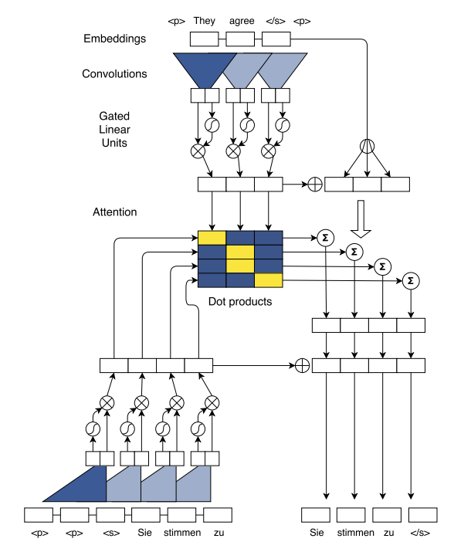
Paraphrases using FairSeq translation models: generation principle
Quels sont les frais pour mes achats en devises étrangères
En-Fr
Fr-En
Quels sont les frais pour mes achats en devises étrangères ?
Quels sont les frais de mes achats en devises étrangères ?
Quels sont les frais liés à mes achats en devises étrangères ?
Quels sont les frais relatifs à mes achats en devises étrangères ?
Quels sont les frais pour mes achats en devises étrangères
N-Best Output
What are the fees for my purchases in foreign currency?

Slide 9
Variable quality
Not all the pivots generate interesting paraphrases:
Poor translation quality: need of specific training data with domain vocabulary
No paths founds: lack of alternative training samples
O what is securecode mc? H -1.2544984817504883 ce qui est P -3.9059 -0.1454 -0.3986 -0.5680 H -1.8877270221710205 quelle est la P -3.9303 -0.1401 -0.6587 -2.8219 H -2.0138516426086426 ce qui constitue P -3.9059 -0.1454 -3.6140 -0.3900 H -2.297175884246826 quelle est P -3.9303 -0.1401 -2.8212 H -2.350461721420288 ce qui P -3.9059 -0.1454 -3.0000
O how does the online travel agency work?
H -0.5921766757965088 Comment fonctionne l'agence de voyage en ligne ?
P -1.4640 -0.2976 -0.1389 -0.2035 -0.5168 -0.2205 -0.1262 -2.2518 -0.1104
H -0.6121525764465332 Comment fonctionne l'agence de voyage en ligne ?
P -1.4640 -0.2976 -0.1389 -0.2035 -0.5168 -0.2205 -0.1262 -1.9298
H -0.6349586248397827 Comment fonctionne l'agence de voyage en ligne
P -1.9883 -0.2784 -0.1399 -0.1977 -0.5074 -0.2056 -0.1306 -1.6317
H -0.6496667861938477 Comment fonctionne l'agence de voyage en ligne ? ?
P -1.4640 -0.2976 -0.1389 -0.2035 -1.0236 -0.2083 -0.1514 -2.2531 -0.1067
H -0.6706180572509766 Comment fonctionne l'agence de voyage en ligne ?
P -1.4640 -0.2976 -0.1389 -0.2035 -1.0236 -0.2083 -0.1514 -1.8778

Slide 10
Experiment
Data
374 questions from the NBC FAQ base
Each question surface form has at least one alternative formulation
We train 2 NLU models:
Model A: original query and alternative sequences
Model B: original query and paraphrases (10 max) generated using FairSeq NMT
Model C: original query and alternative sequences generated by replacement rules
Training:
Rasa NLU (Intent classifier)
TensorFlow: 100 epoch (converge faster with model A)
Preprocessing pipeline with stemming, normalization, and removal of stopwords
Measure A and B with Accuracy & F-Score
Quelle est la différence entre un compte chèques et un compte épargne?
Quelle différence existe entre un compte épargne et un compte chèque?

Slide 11
Results
Performance of various configurations
Model | Accuracy | Precision | F-Score
Model A: One alternative paraphrase model | 0.68194 | 0.5669 | 0.602
Model B: Pivotal translation 10 paraphrases model | 0.943 | 0.918 | 0.926
Model C: Using rule based baseline paraphrase generator | 0.892 | 0.887 | 0.903
Models generated and measured using Rasa Framework

Slide 12
Observations and Discussion
There is a gain using translation pivot to generate paraphrases instead of a rule based system.
The gain is not maximized because of variability in output quality from the FairSeq translation model.
It is important to improve and customize standard training models (WMT 14 & 17) for domain specific needs in paraphrasing.

Slide 13
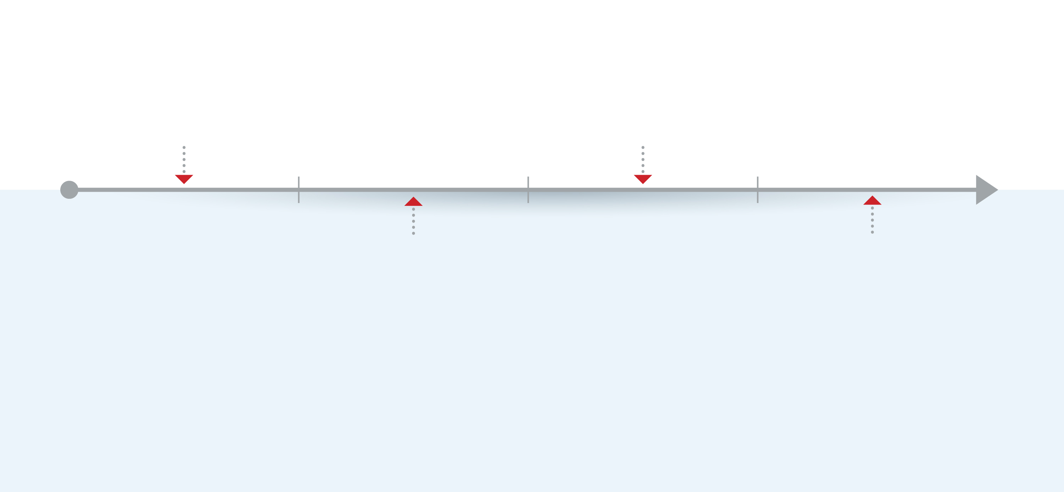
Next steps
A lot of possibilities of configuration are given by FairSeq and need to be tested
Use generic rules to rewrite some portions of paraphrases to improve quality
Improving parametrization
Experiment post-processing
Build FairSeq Training models with dedicated vocabulary
Using new pivots
Using other available languages like German or Spanish as pivotal
Use specific sentences and keyword dictionaries related to the semantic domain targeted.

Slide 14
Thank you!
Twitter.com/ericcharton

